Slide 1

Shopping Website
CS331 Section 2
Group Members : G7
Mridul Mayank (1901114)
Prabhat Kumar Rajak (1901139)
Navneet Ranjan (1901118)
Nikita Gupta (1901121)

Slide 2

Purpose
The purpose of developing this web application is to provide a common platform where different stores of the market can sell their product.
Scope:
It will integrate the benefits of non-physical contact purchasing where customers will have to purchase from the web app and their product is delivered to them. It also provides opportunities to those small daily essentials stores to sell their product along with big stores and have a fair competition.

Slide 3
Existing System
The present system does not allow customers to purchase their required items from different kind of stores non-physically from nearby localities.
So in this pandemic it is necessary for the people to purchase non-physically.
The small stores can not sell their product to the large number of customers.
People in village area do not get premium product around their location due to unavailability of good stores.
Stores have monopolised their access to some locations which needs to be tackled for fair competition in the market.
Currently, delivery system is slow due to which it takes 4-5 days for a product to be deliver

Slide 4
Proposed System
This app gives fair opportunities to all the sellers on the platform to showcase their products and sell them.
Customers can order their product sitting at home and there will be no need to do the physical shopping.
Also, this application targets to promotes technology like digital payment.
Like in the markets, we have all kind of stores. Here also we provide the customers to choose which type of shopping they want to do.
There will be separate sections for different kind of products like medicines, cosmetics, clothing etc. from which the customer can select to purchase.
All users will be registered on the app.
All users will have the full access of their data like purchasing history..

Slide 5
Functional Requirements
1. All users on the Application (including customers and sellers) must have a user id and password to log in.
2. Seller will have the privilege to add photo, price and their quantity of product on the app.
3. Customers will have full liberty to choose and purchase products that are showcased on our app.
4. Customers can also rate and comment on delivery processes and products.
5. Customer can view their order history.
6. Customer can also add their address for their delivery.
7. Customer can view their product in the cart screen from the cart.
8. Seller can view their products.
9. Customer can choose their product as per the category.
10. Customer will have to do the payment for placing an order

Slide 6
Non-Functional Requirements
1. Maximum time availability.
2. User friendly interface.
3. Data security of the users.

Slide 7
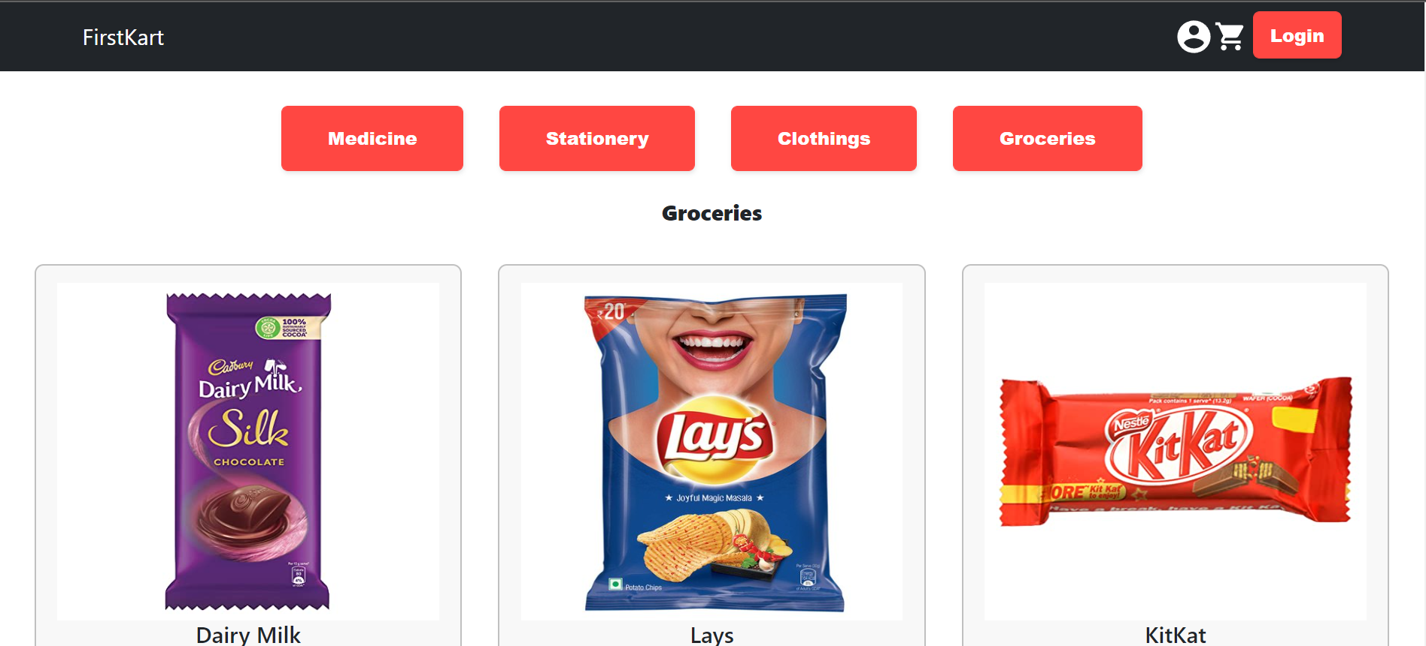
Home Page
Cart
Category
Navbar
Customer Profile
Login Button

Slide 8
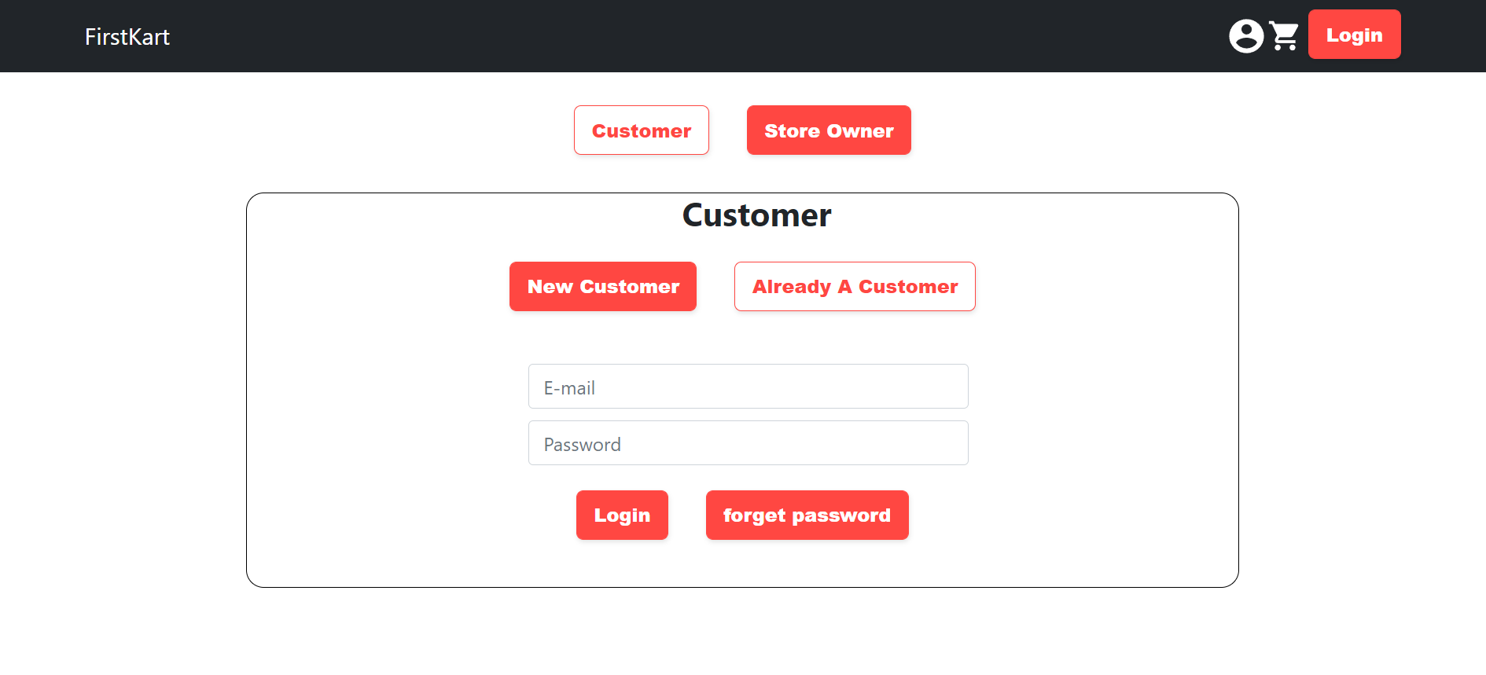
Login Page for Customer
In this page, the users are given the option to login or register as customer or owner where the options are :
New customer => if the user is new to web app.
Already a customer => if the user has already registered on the app.
Also, users have the option to reset password by simply clicking on the forget password button.

Slide 9
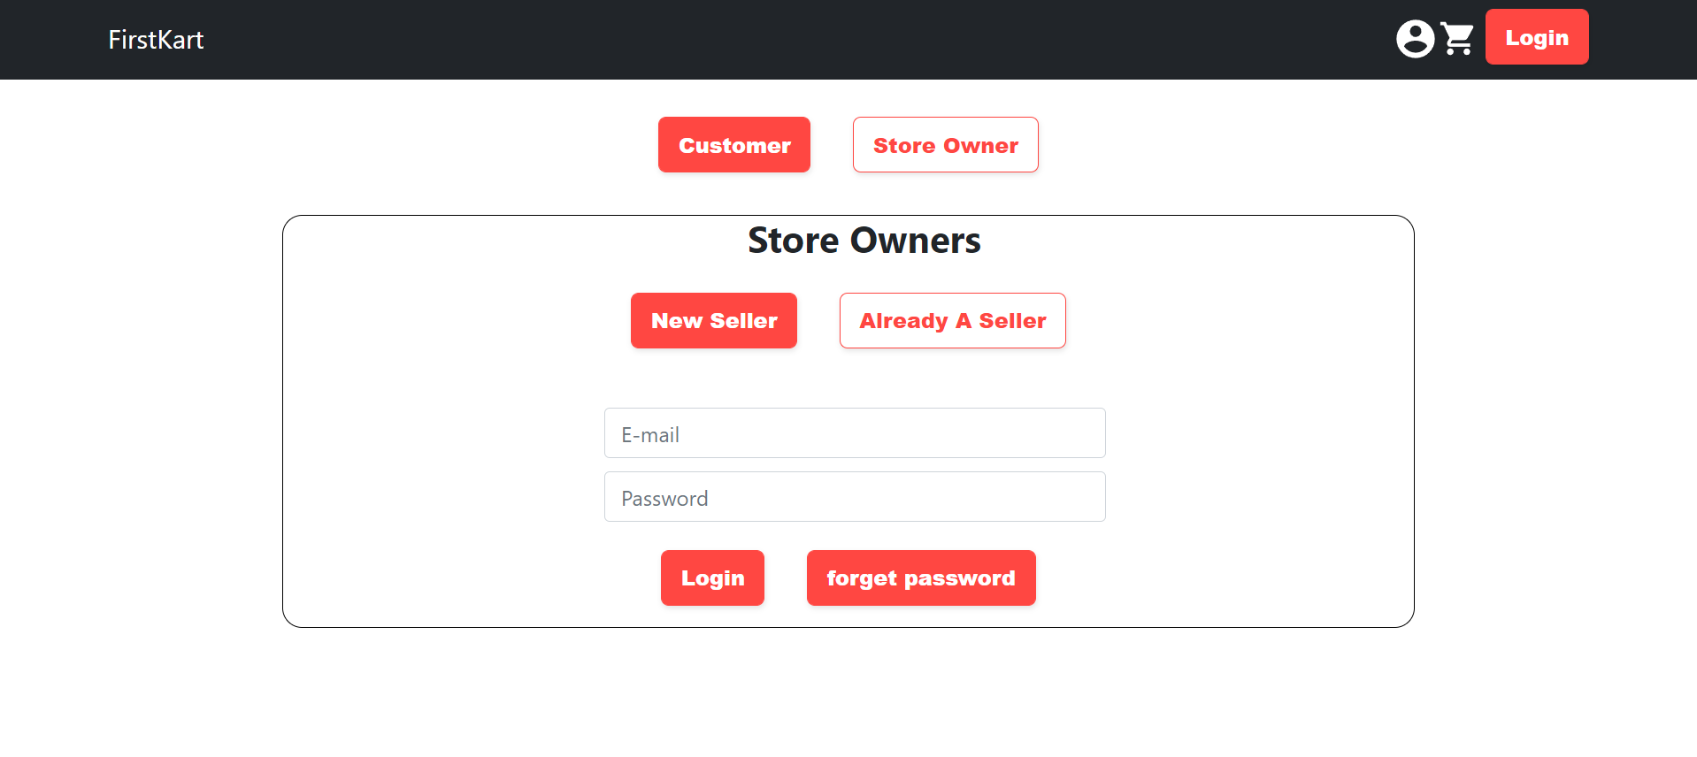
Login Page for Store Owners

Slide 10
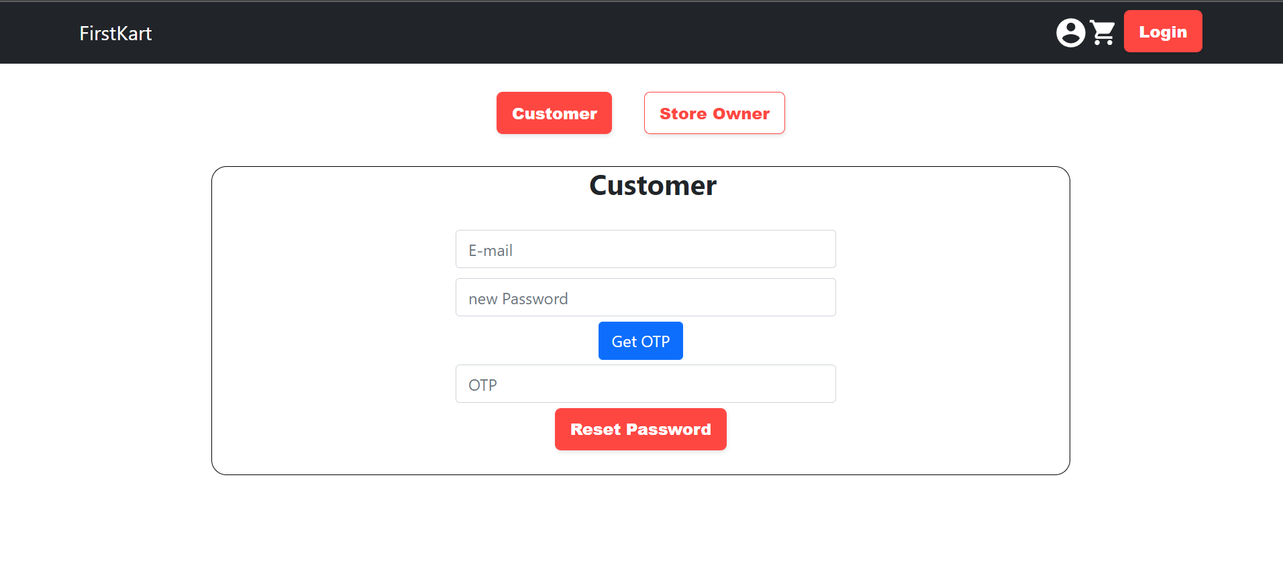
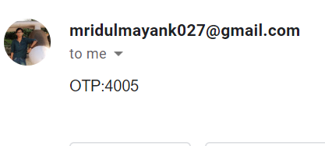
Forgot Password Page
Here, user can change the password where he/she gets an otp and after confirming the otp, the password is reset.
Here we are using nodemailer for the mail and otp functionality and the otp is sent to the mail.

Slide 11
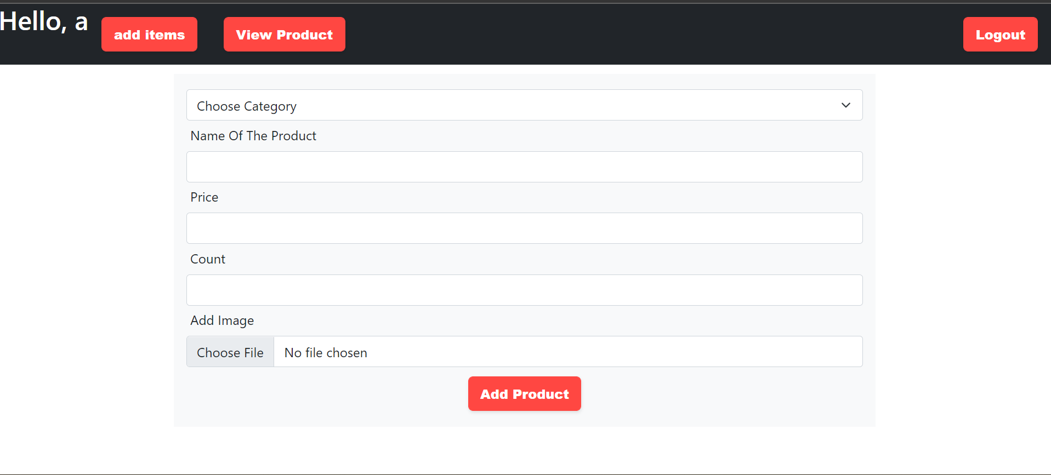
Owner Add Item:
Owner can add items to the database. Where he will have to specify the name,price,category and will have to add the image for the product.

Slide 12
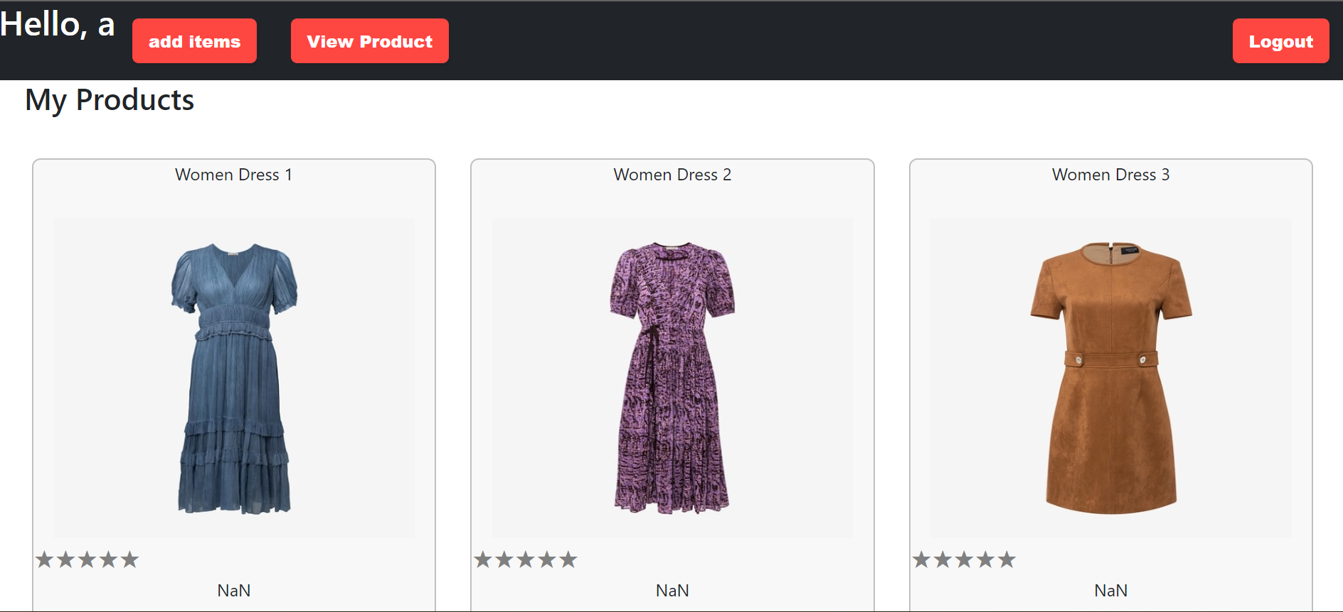
Owner’s Product:
Here, Owner can see all his products. He is also given the liberty to view, delete and update his product.

Slide 13
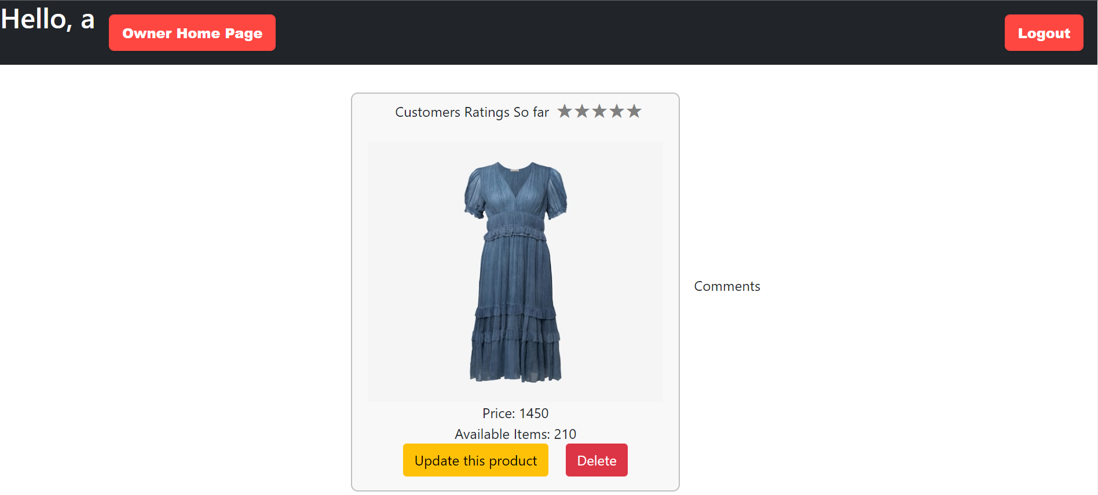
Owner view product
After clicking the view/Update product button owner can see his product. Here, owner is given two options i.e, update the product or delete .Delete button deletes the product and update button redirects to a new page where owner can update the product

Slide 14
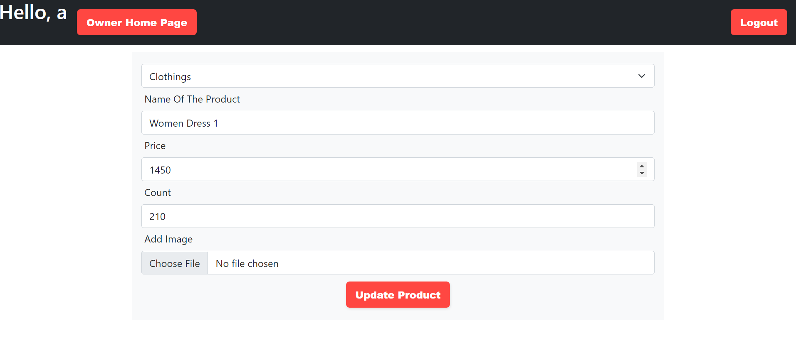
Owner Update Product:
Owner will have to fill the form with the values which he wants to modify. On clicking the button “Update Product ”, The product will be updated!!!

Slide 15
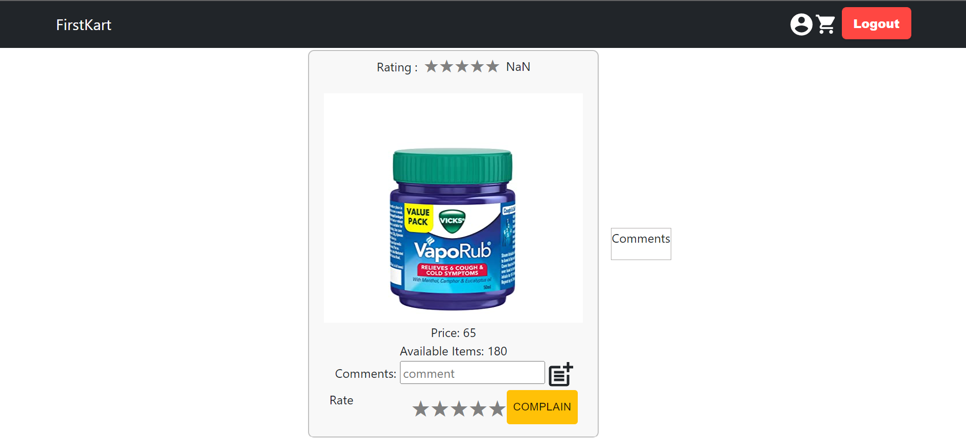
View Product
This is the view product page where customer can view the product, rate it and add comments to the product. Also customer can complain about the product.

Slide 16
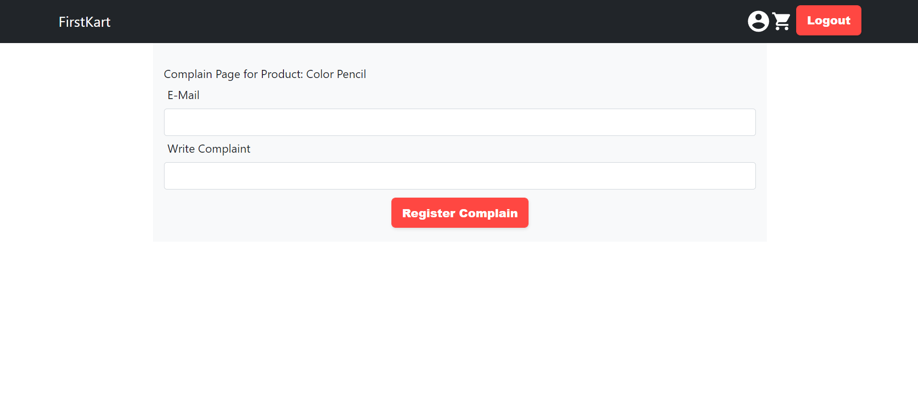
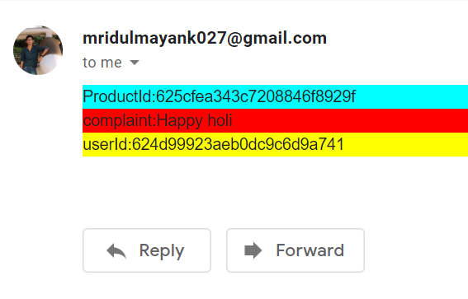
Complaint Page:
Here, customer can register the complaint about the product and mail will be sent to us.

Slide 17
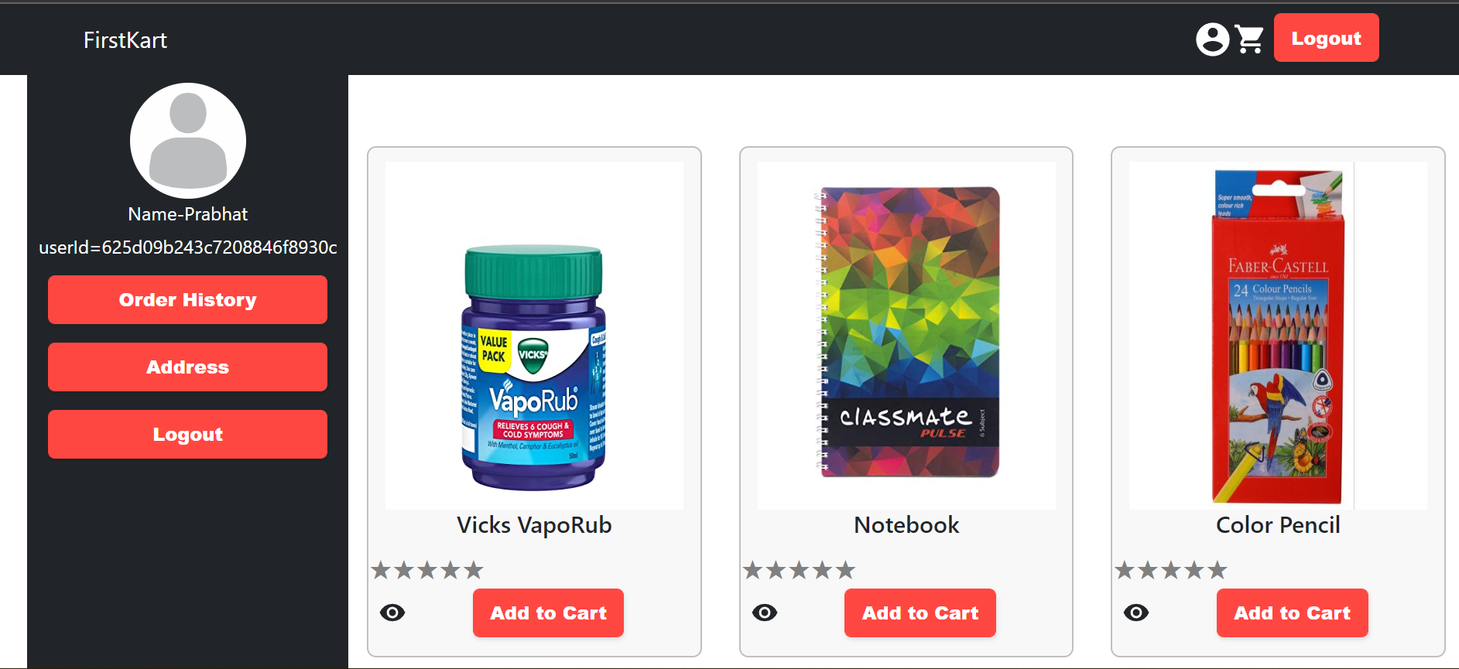
Customer’s profile
Customer can view their ordered history, saved addresses, can save new address also.
Also customer can directly logout from here.

Slide 18
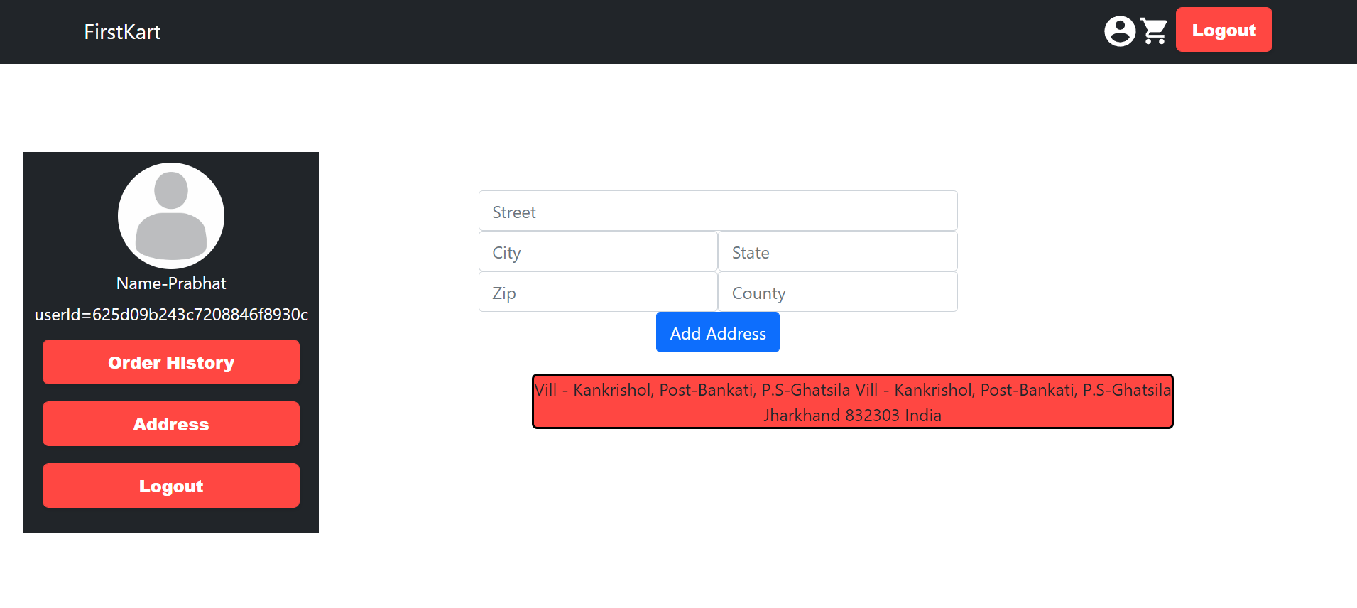
Customer’s profile
Here, customer can add address and view their already saved addresses

Slide 19
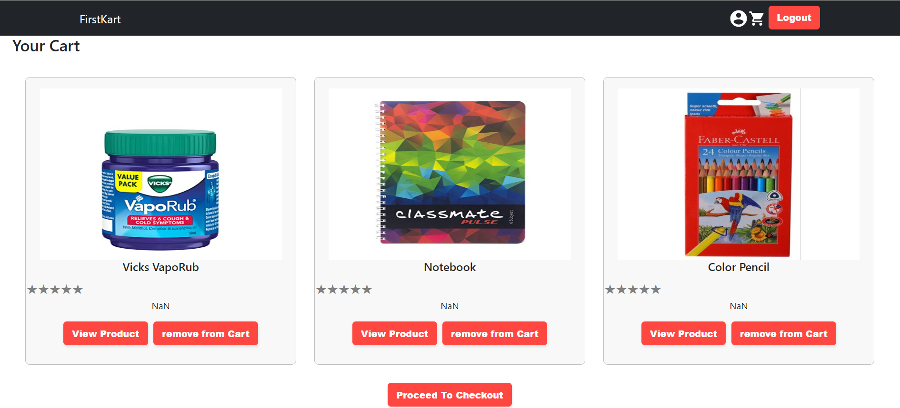
Cart
This is the cart page of the customer where he can view the products in his cart. Also each product can be viewed or deleted from the cart. If everything is per the desire, then the customer can checkout to payment and finally place order.

Slide 20
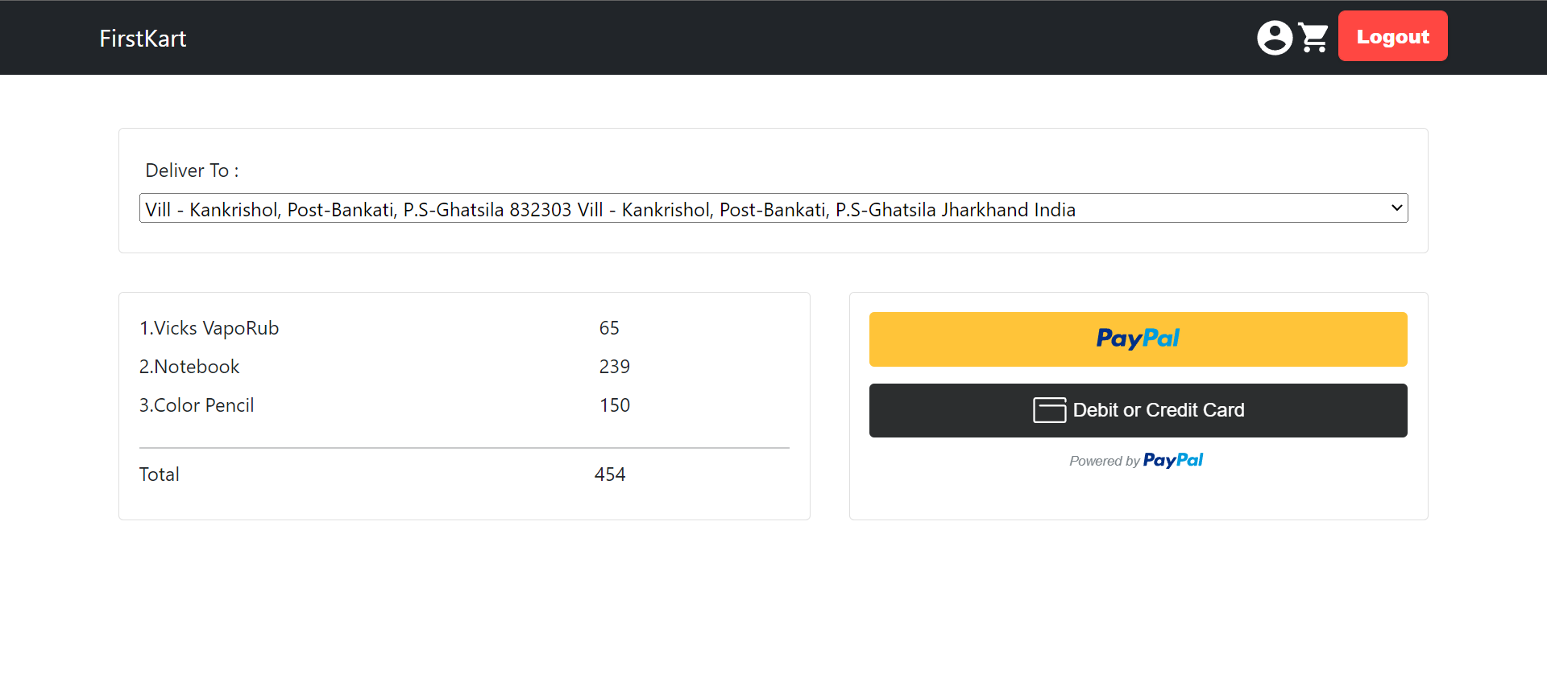
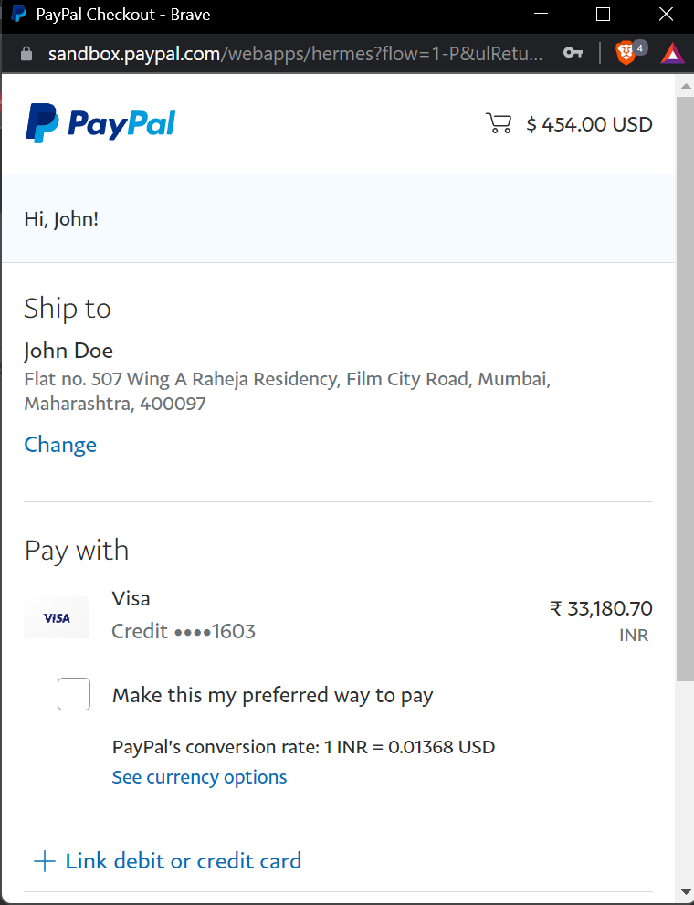
Payment
This is the checkout cum payment page where the customer chooses the delivery address and chooses the payment option through paypal gateway to place the order.
After selecting the payment method, the paypal gateway activates through which we can pay .

Slide 21










Technologies Used:

Slide 22
Contributions
Mridul Mayank:
Implemented the backend services
Implemented the Forget Password functionality
Implemented the view Product functionality
Tested the web app
Implemented the home page for customer
Managed the CRUD operations and database.

Slide 23
Prabhat Kumar Rajak :
Implemented the payment option and paypal gateway.
Implemented the home page for Owner
Implemented the Cart Screen.
Implemented the Complain page.
Implemented the update product details.
Helped with managing database.

Slide 24
Navneet Ranjan:
1. Implemented the Profile Page of the customer.
2. Implemented the Login page of Customer and Owner.
3. Implemented form for updating the product details.
4. Helped with frontend.

Slide 25
Nikita Gupta:
Implemented functionality of the upload product by the owner .
Implemented the deletion of the product by the owner.
Helped with frontend of the application.
Presentation.

Slide 26


